Slide 1
NIST Hacking Case
Notes:
# The following commands will install all tools needed for Data Leakage Case. We will upgrade the script to add more tools for other labs soon.
wget https://raw.githubusercontent.com/frankwxu/digital-forensics-lab/main/Help/tool-install-zsh.sh
chmod +x tool-install-zsh.sh
./tool-install-zsh.sh

Slide 2
Scenario
On 09/20/04 , a Dell CPi notebook computer, serial # VLQLW, was found abandoned
it has a wireless PCMCIA card and an external homemade 802.11b antennae.
It is suspected that this computer was used for hacking purposes
It may be tied to a hacking suspect, Greg Schardt.
Schardt also goes by the online nickname of “Mr. Evil”
Some of his associates have said that he would park his vehicle within range of Wireless Access Points (like Starbucks and other T-Mobile Hotspots) where he would then intercept internet traffic, attempting to get credit card numbers, usernames & passwords.

Slide 3
Goal: is Greg Schardt a hacker?
Find
Any hacking software if there are any
Usage of evidence software
Any data that might have been generated.
intercepted internet traffic, credit card numbers, usernames & passwords
Attempt to tie the computer to the suspect.

Slide 4
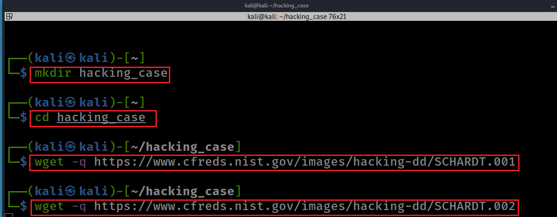
Get DD images
Download DD images
repeat wget 8 times…
Notes:
mkdir hacking_case
cd hacking_case
wget -q https://www.cfreds.nist.gov/images/hacking-dd/SCHARDT.001
wget -q https://www.cfreds.nist.gov/images/hacking-dd/SCHARDT.002
wget -q https://www.cfreds.nist.gov/images/hacking-dd/SCHARDT.003
wget -q https://www.cfreds.nist.gov/images/hacking-dd/SCHARDT.004
wget -q https://www.cfreds.nist.gov/images/hacking-dd/SCHARDT.005
wget -q https://www.cfreds.nist.gov/images/hacking-dd/SCHARDT.006
wget -q https://www.cfreds.nist.gov/images/hacking-dd/SCHARDT.007
wget -q https://www.cfreds.nist.gov/images/hacking-dd/SCHARDT.008

Slide 5
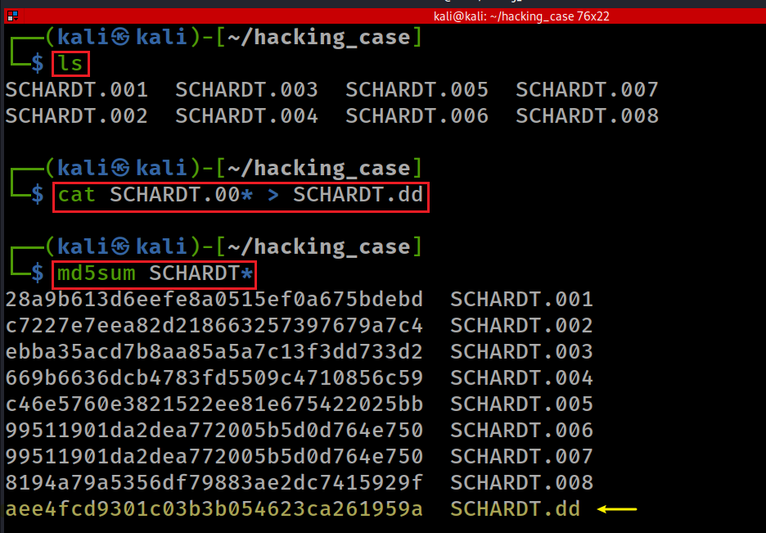
1. What is the image hash? Does the acquisition and verification hash match?
Merge .00? to one dd image
Check MD5
Notes:
cat SCHARDT.00* > SCHARDT.dd
md5sum SCHARDT*
aee4fcd9301c03b3b054623ca261959a

Slide 6
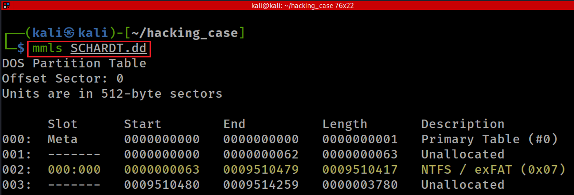
2. What operating system was used on the computer?
Show partitions (NTFS) and unallocated space using mmls
Notes:
mmls SCHARDT.dd

Slide 7
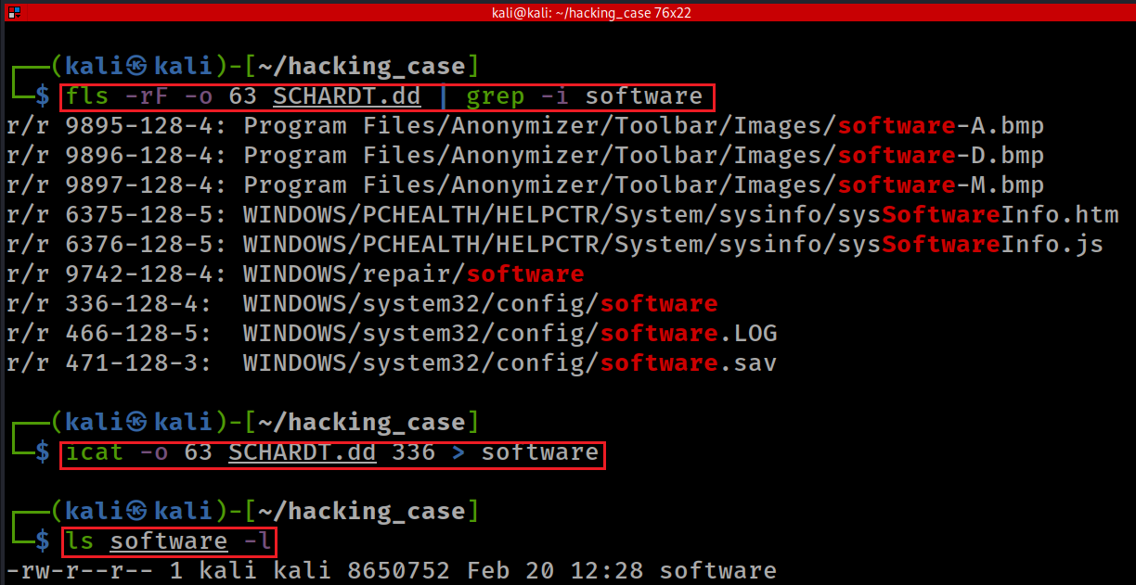
Extract software, which contains OS information saved in Win registry
Notes:
fls -rF -o 63 SCHARDT.dd | grep -i software
icat -o 63 SCHARDT.dd 336 > software
ls software -l

Slide 8
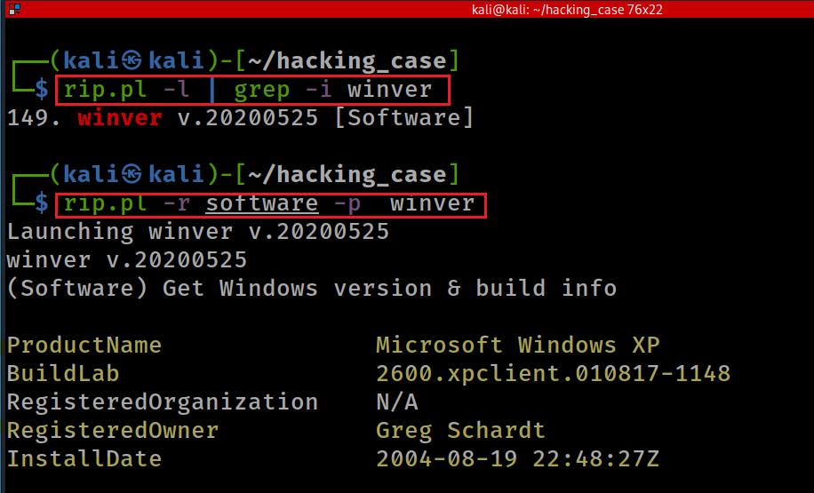
Find regrip plugin
Find winver
Notes:
sudo apt-get install regripper
ProductName Microsoft Windows XP
BuildLab 2600.xpclient.010817-1148
RegisteredOrganization N/A
RegisteredOwner Greg Schardt
InstallDate 2004-08-19 22:48:27Z

Slide 9

3. When was the OS install date?
See previous slide
InstallDate 2004-08-19 22:48:27Z

Slide 10
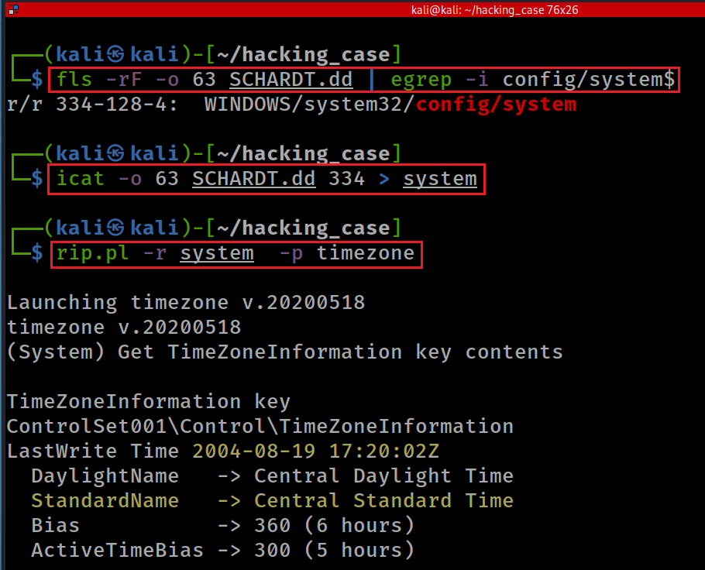
4. What is the timezone settings?
Search for “system”
$ To the end of the line.
Extract “system”
Find timezone
Notes:
fls -rF -o 63 SCHARDT.dd | egrep -i config/system$
icat -o 63 SCHARDT.dd 334 > system
rip.pl -r system -p timezone
https://ryanstutorials.net/linuflsxtutorial/cheatsheetgrep.php

Slide 11
5. Who is the registered owner?

Slide 12
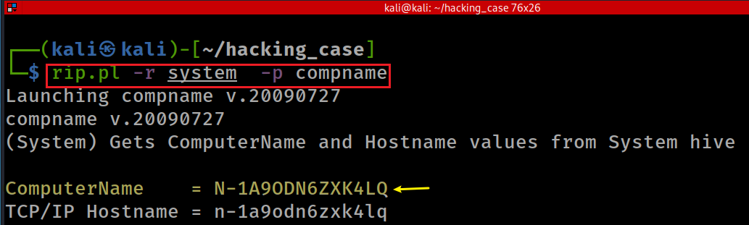
6. What is the computer account name?
Notes:
rip.pl -r system -p compname

Slide 13
7. What is the primary domain (workgroup) name?
Windows domain is associated with workgroup
and PC name, IP address
Workgroup can be found in system event log
We need to
search workgroup in system event log
extract the event log
find a tool to parse the event log
find domain information

Slide 14
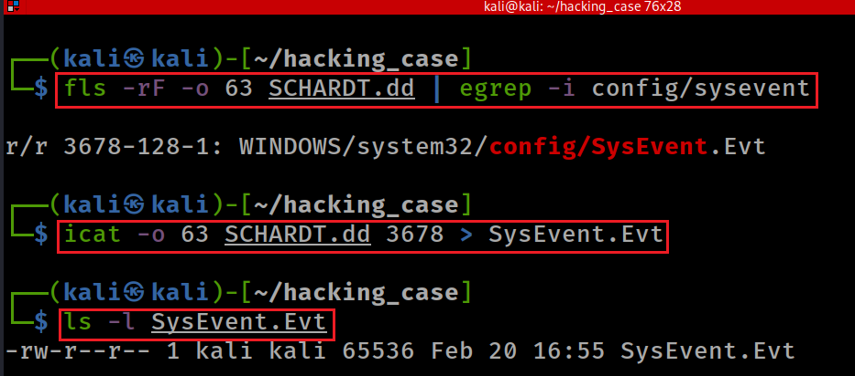
Dump system event log
Notes:
fls -rF -o 63 SCHARDT.dd | egrep -i config/sysevent
icat -o 63 SCHARDT.dd 3678 > SysEvent.Evt

Slide 15
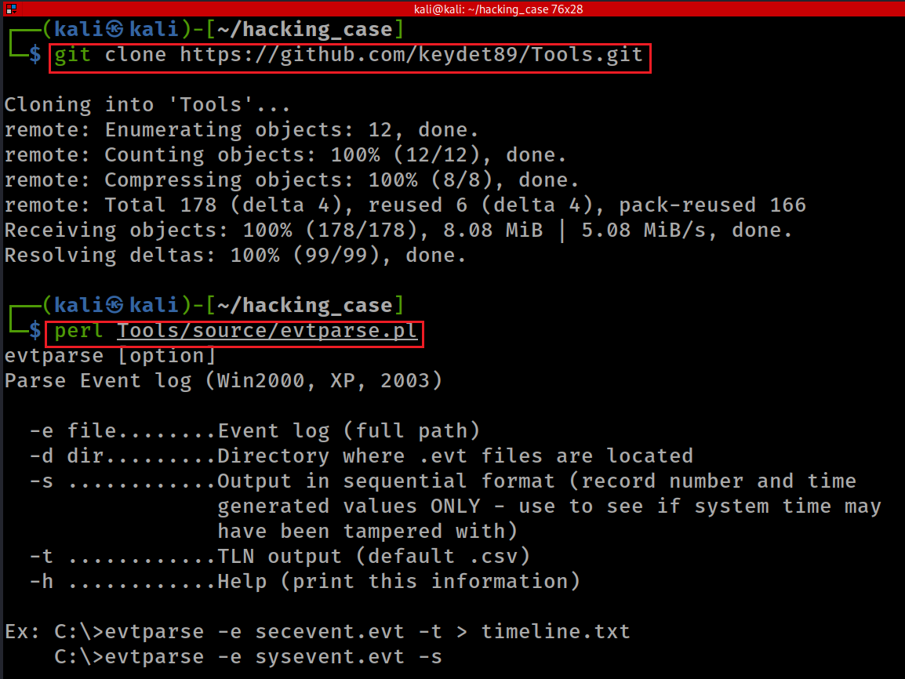
Download evtparse
Test evtparse
Notes:
git clone https://github.com/keydet89/Tooper
perl Tools/source/evtparse.pl

Slide 16
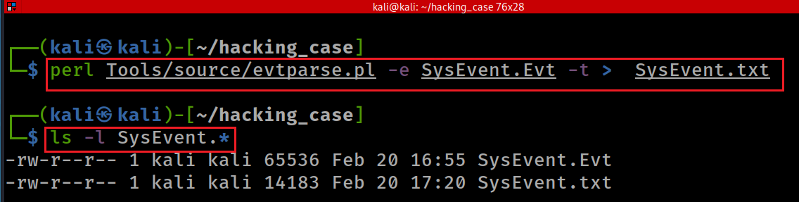
Parse System Event log

Slide 17
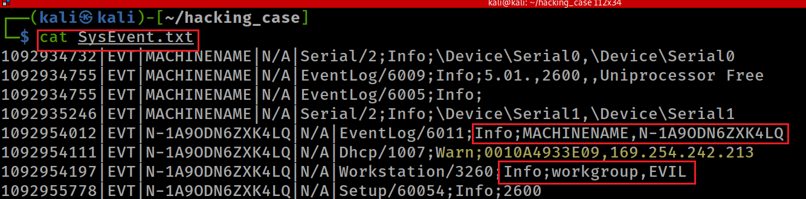
find domain information, PC name, etc.

Slide 18
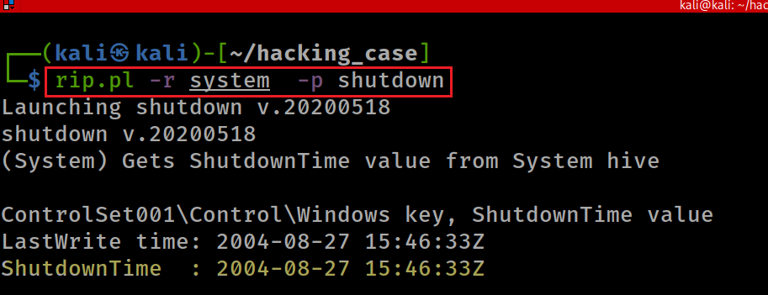
8. When was the last recorded computer shutdown date/time?
Notes:
rip.pl -r system -p shutdown

Slide 19
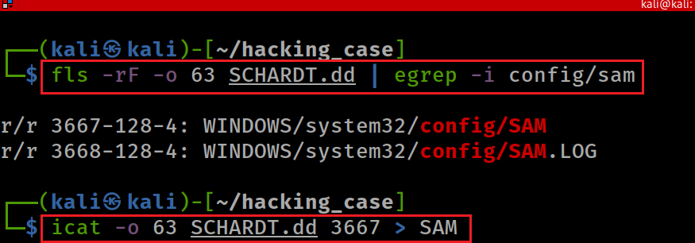
9. How many accounts are recorded (total number)?
All Windows user account names, SIDs (Security Identifiers), login counts, creation dates, last password change dates, groups, and much more can be found in the Windows Registry SAM (Security Account Manager) file.
Notes:
fls -rF -o 63 SCHARDT.dd | egrep -i config/sam
icat -o 63 SCHARDT.dd 3667 > SAM
rip.pl -r SAM -p samparse

Slide 20
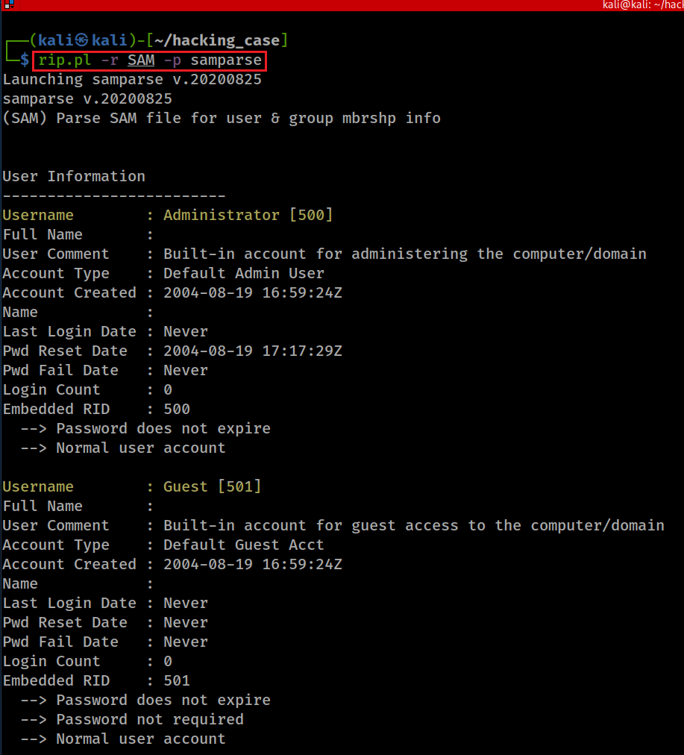
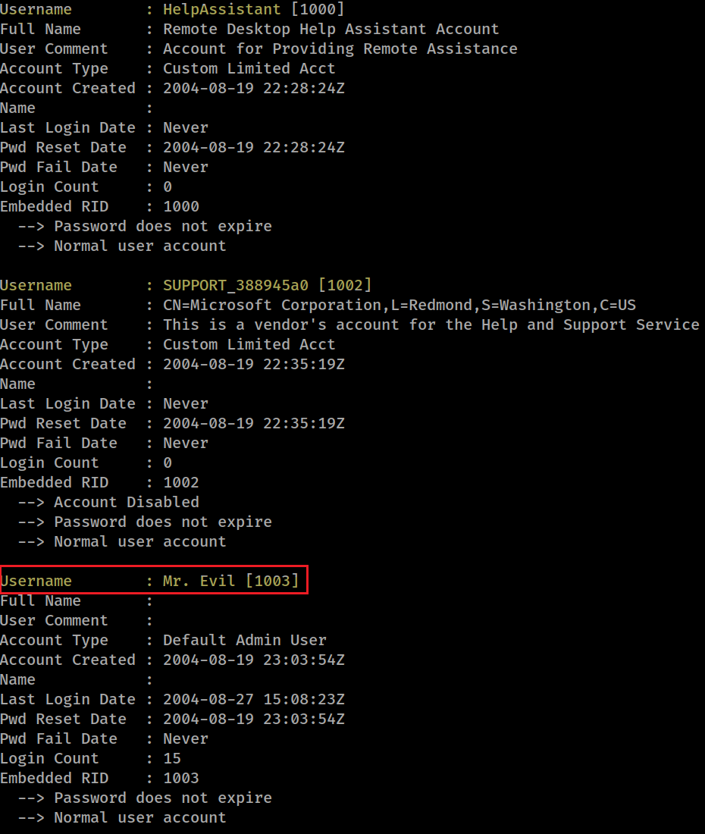

Slide 21
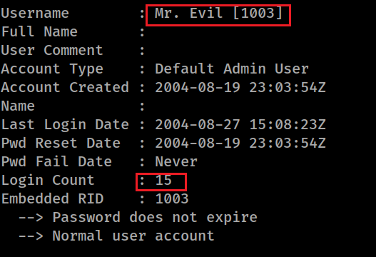
10. What is the account name of the user who mostly uses the computer?
Same as question 9

Slide 22
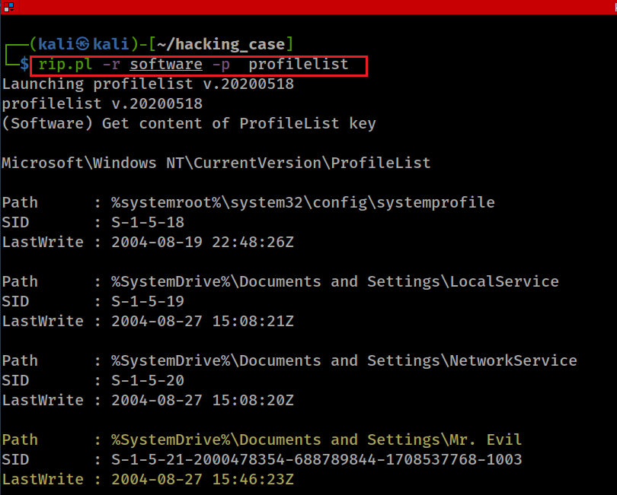
11. Who was the last user to logon to the computer?
Method 1
shutdown
Notes:
rip.pl -r software -p profilelist

Slide 23
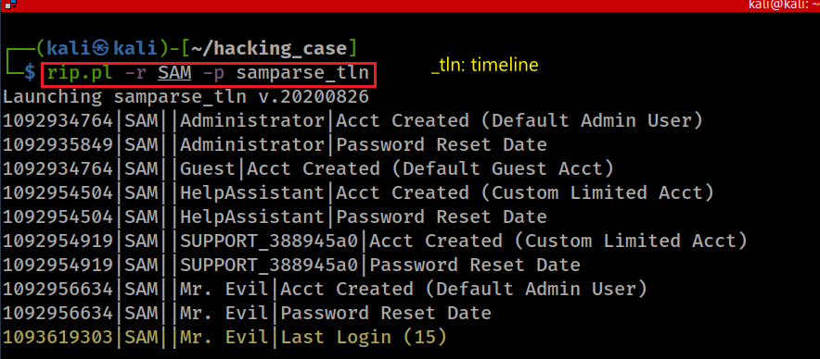
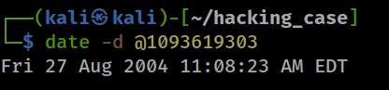
Method 2
epoch to a date
Notes:
rip.pl -r SAM -p samparse_tln
date -d @1093619303
1092934764|SAM||Administrator|Acct Created (Default Admin User)
1092935849|SAM||Administrator|Password Reset Date
1092934764|SAM||Guest|Acct Created (Default Guest Acct)
1092954504|SAM||HelpAssistant|Acct Created (Custom Limited Acct)
1092954504|SAM||HelpAssistant|Password Reset Date
1092954919|SAM||SUPPORT_388945a0|Acct Created (Custom Limited Acct)
1092954919|SAM||SUPPORT_388945a0|Password Reset Date
1092956634|SAM||Mr. Evil|Acct Created (Default Admin User)
1092956634|SAM||Mr. Evil|Password Reset Date
1093619303|SAM||Mr. Evil|Last Login (15)

Slide 24

12. Proves that Greg Schardt is Mr. Evil
A search (on local PC) for the name of “Greg Schardt” reveals multiple hits. One of these proves that Greg Schardt is Mr. Evil and is also the administrator of this computer. What file is it? What software program does this file relate to?
Approach
Search “Greg” and check if the name associated with “Evil”
In order to search, we need to mount the DD image

Slide 25
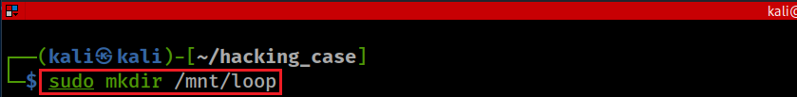
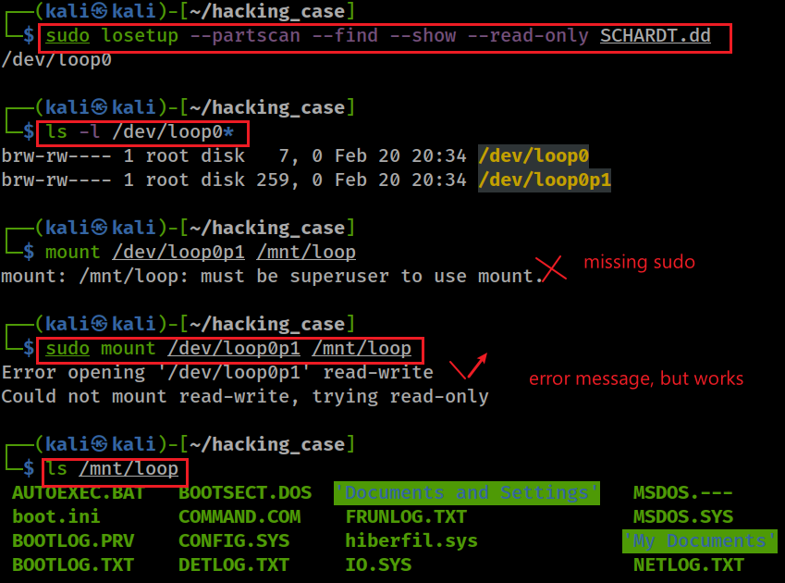
Create a mounting point
Setup a loop device
Mount dd to the mounting point
Notes:
sudo mkdir /mnt/loop
sudo losetup --partscan --find --show --read-only SCHARDT.dd
sudo mount /dev/loop0p1 /mnt/loop

Slide 26
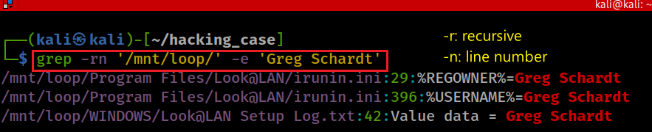
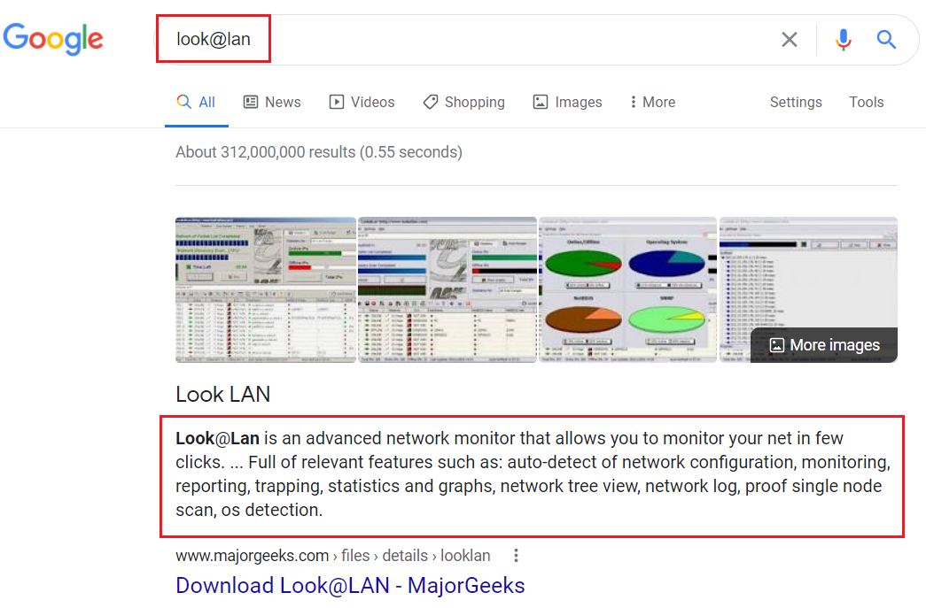
Search globally for the string “Grep Schardt”
Observation:
look@lan is a software because it was installed under the “Program Files” folder
look@lan has a configuration file named “irunin.ini”
The initial config file has owner and user name information.
The config file has a setup log
Notes:
grep -rn '/mnt/loop/' -e 'Greg Schardt'
/mnt/loop/Program Files/Look@LAN/irunin.ini:29:%REGOWNER%=Greg Schardt
/mnt/loop/Program Files/Look@LAN/irunin.ini:396:%USERNAME%=Greg Schardt
42:Value data = Greg Schardt

Slide 27
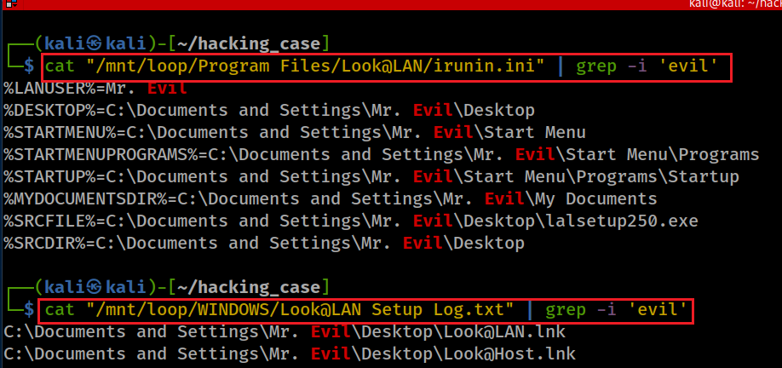
Search for the string “evil”

Slide 28
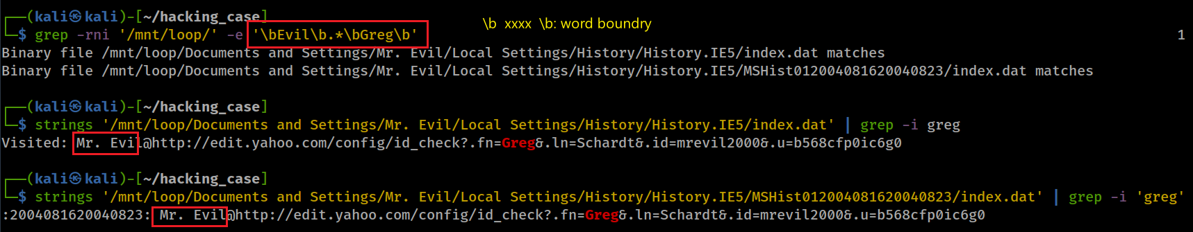
Other evidence may helpful:
Search both key words “”Evil” and “Greg”. The search results show Evil is associated with yahoo web visits.
Notes:
grep -rni '/mnt/loop/' -e '\bEvil\b.*\bGreg\b’
strings '/mnt/loop/Documents and Settings/Mr. Evil/Local Settings/History/History.IE5/index.dat' | grep -i greg
strings '/mnt/loop/Documents and Settings/Mr. Evil/Local Settings/History/History.IE5/MSHist012004081620040823/index.dat' | grep -i 'greg'

Slide 29
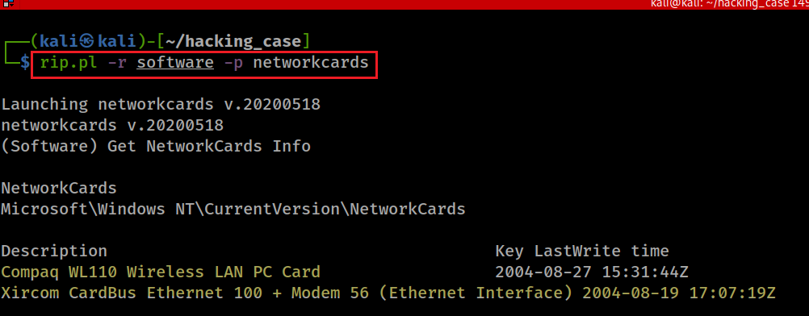
13. List the network cards used by this computer
Notes:
rip.pl -r software -p networkcards
Compaq WL110 Wireless LAN PC Card 2004-08-27 15:31:44Z
Xircom CardBus Ethernet 100 + Modem 56 (Ethernet Interface) 2004-08-19 17:07:19Z

Slide 30
14. This same file reports the IP address and MAC address of the computer. What are they?
list all files contain IP address
1
list all files contain MAC address
2
Find intersection of two files
3

Slide 31
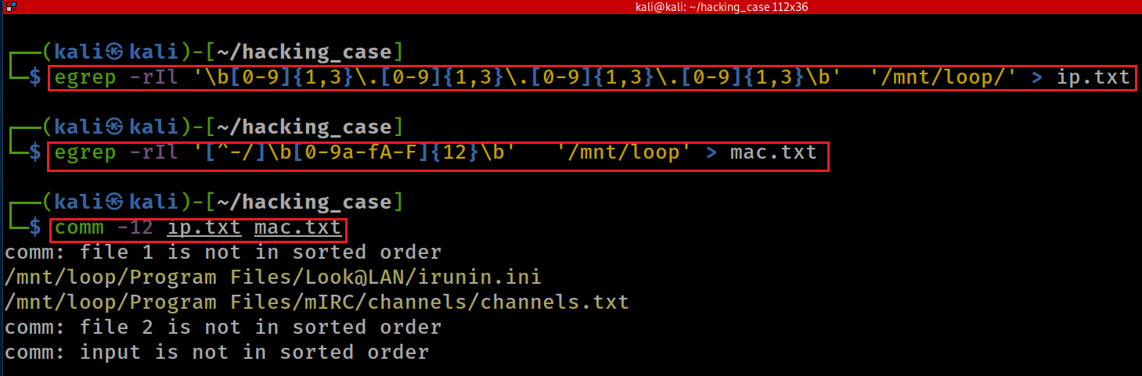
egrep or grep –E: Run grep with extended regular expressions.
-r: Recursively search
I: ignore binary file
l: only list file name
\b: Match either the beginning or end of a word.
[^]: match anything except the characters within a bracket by beginning the list of characters within the brackets with a ^ character.
Notes:
egrep -rIl '\b[0-9]{1,3}\.[0-9]{1,3}\.[0-9]{1,3}\.[0-9]{1,3}\b' '/mnt/loop/' > ip.txt
egrep -rIl '[^-/]\b[0-9a-fA-F]{12}\b' '/mnt/loop' > mac.txt
comm -12 ip.txt mac.txt
https://ryanstutorials.net/linuxtutorial/cheatsheetgrep.php
https://ryanstutorials.net/linuxtutorial/grep.php
https://stackoverflow.com/questions/3185457/pattern-matching-digits-does-not-work-in-egrep
https://www.digitalocean.com/community/tutorials/using-grep-regular-expressions-to-search-for-text-patterns-in-linux

Slide 32
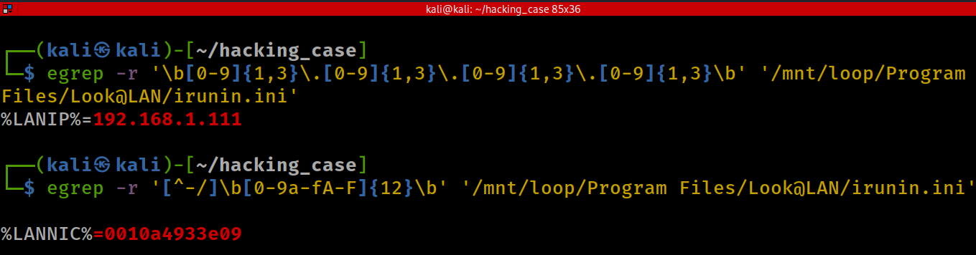
Verify irunin.ini has both IP and MAC addresses
Notes:
egrep -r '\b[0-9]{1,3}\.[0-9]{1,3}\.[0-9]{1,3}\.[0-9]{1,3}\b' '/mnt/loop/Program Files/Look@LAN/irunin.ini’
or
grep -rP '\b[0-9]{1,3}\.[0-9]{1,3}\.[0-9]{1,3}\.[0-9]{1,3}\b' '/mnt/loop/Program Files/Look@LAN/irunin.ini’
or
grep -rP '\b\d{1,3}\.\d{1,3}\.\d{1,3}\.\d{1,3}\b' '/mnt/loop/Program Files/Look@LAN/irunin.ini'
egrep -r '[^-/]\b[0-9a-fA-F]{12}\b' '/mnt/loop/Program Files/Look@LAN/irunin.ini'

Slide 33
15. Which NIC card was used during the installation and set-up for LOOK@LAN?
MAC addresses are primarily assigned by device manufacturers
Often referred to as the burned-in address.
The IEEE assigns manufacturers the numbers, called organizationally unique identifiers (6 Hex).
The remaining bits of each MAC address act as a serial number, assigned to a NIC when it is made.

Slide 34
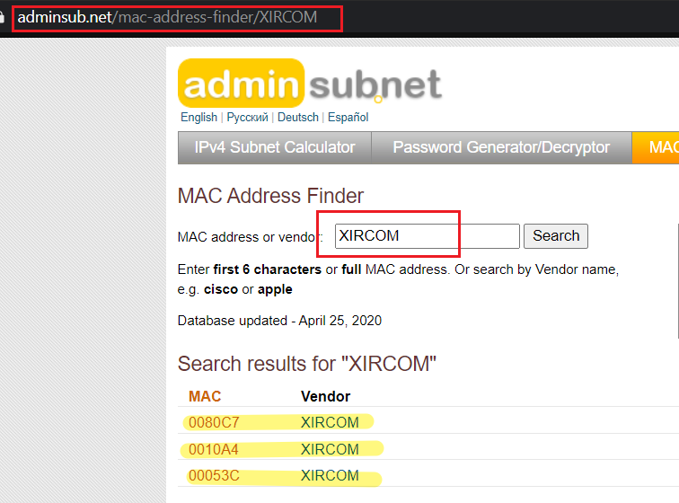
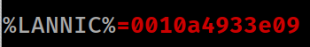
https://www.adminsub.net/mac-address-finder/XIRCOM
It proves that the XIRCOM was used during the installation and set-up for LOOK@LAN.

Slide 35
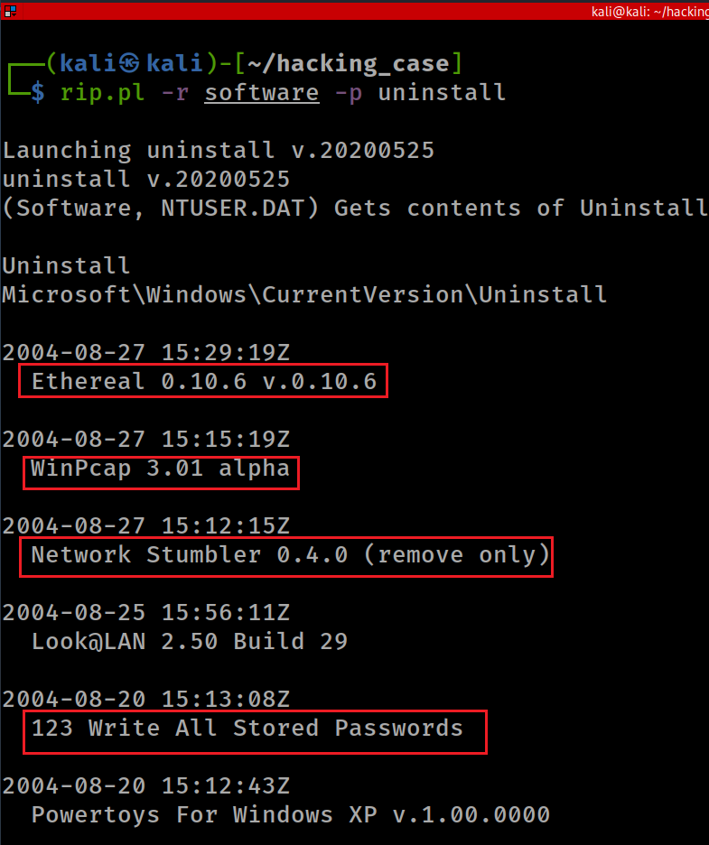
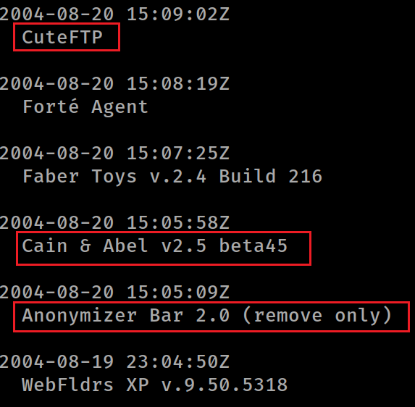
16. Find 6 installed programs that may be used for hacking.

Slide 36
Hacking Programs Explained
Ethereal: “Ethereal is a sniffer, an application that can capture all packets sent through a network to then interpret them and see what tasks are being carried out on the network.”
Network Stumbler: “Network stumbler is a wifi scanner and monitor tool for windows, it allows you to detect WLANs using 802.11a, 802.11b and 802.11g wireless cards.”
WinPcap: “Enables applications to send and receive raw network packets to/from network cards. Receiving raw network packets is also known as packet capturing, therefore the name "Windows Packet capture library".
123 Write All Stored: Password Cracker. “A Password Cracker program is used to decrypt a password or password file. Some Password Crackers programmatically try different passwords while others use brute force logging in with passwords word lists.”
Anonymizer Bar 2.0: “The Anonymizer toolbar plug-in hosts seven tools that basically switch your originating Web address to the Anonymizer proxy server, thus concealing your identity.”
Cain and Abel: “The Cain & Abel program is designed to crack passwords in the most difficult situations. Capable of detecting passwords hidden by "asterisks. [Gives user] access to a sniffer - a network traffic analyzer, the purpose of which is to intercept valuable information transmitted over the network.”
CuteFTP: “Allows you to transfer files from your PC to another PC or a server in an easy way, just drag&drop and see how they are transferred.”

Slide 37
17. What is the SMTP email address for Mr. Evil?
NTUSER.DAT Contains Your User Profile Settings
Every time you make a change to the look and behavior of Windows and installed programs, Windows needs to remember your preferences the next time it loads.
whether that’s your desktop background, monitor resolution, or even which printer is the default,
Windows accomplishes this by first storing that information to the HKEY_CURRENT_USER hive.
Then when you sign out or shut down, Windows saves that information to the NTUSER.DAT file.
The next time you sign in, Windows will load NTUSER.DAT to memory, and all your preferences load to the Registry again.
Notes:
https://www.howtogeek.com/401365/what-is-the-ntuser.dat-file/

Slide 38
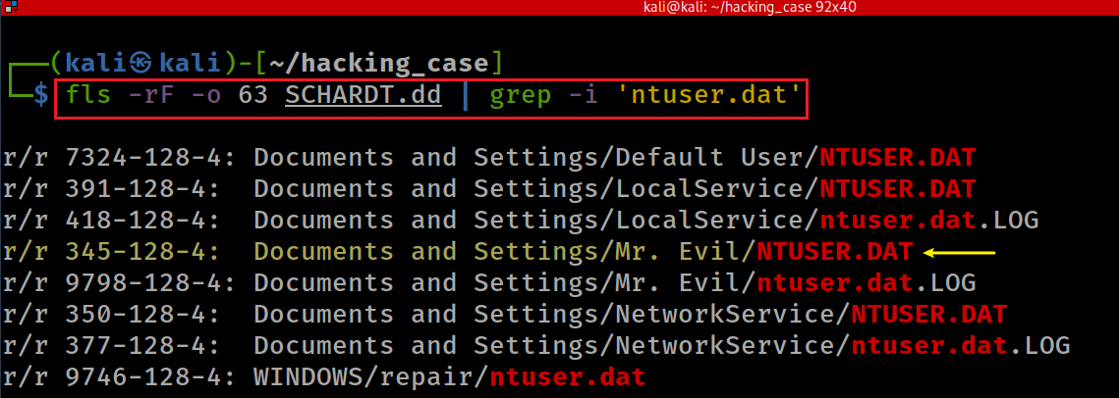
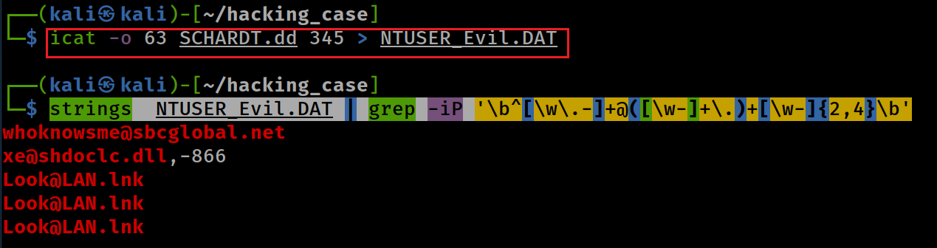
Search for ntuser.data
Extract Evil ntuser.data
Search the email pattern
The strings command returns each string of printable characters in files. Its main uses are to determine the contents of and to extract text from binary files.
Notes:
fls -rF -o 63 SCHARDT.dd | grep -i 'ntuser.dat'
icat -o 63 SCHARDT.dd 345 > NTUSER_Evil.DAT
strings NTUSER_Evil.DAT | grep -iP '\b^[\w\.-]+@([\w-]+\.)+[\w-]{2,4}\b’
https://regex101.com/

Slide 39
18. What are the NNTP (news server) settings for Mr. Evil?
Understand new server
Find new applications installed
Find the application installation directory
Search for configuration files or key words

Slide 40
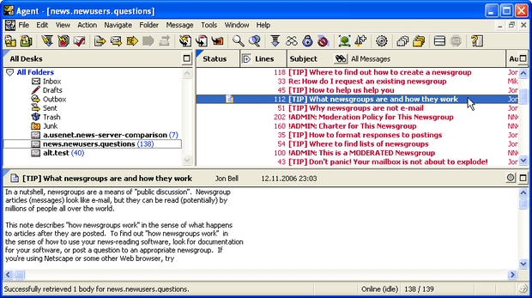
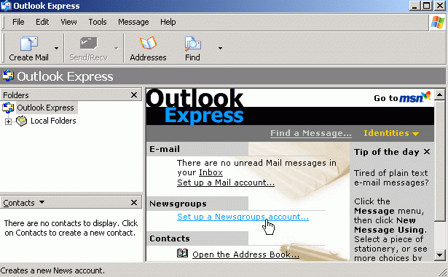
Understand new server
The Network News Transfer Protocol (NNTP) is an application protocol
for transporting Usenet news articles (netnews) between news servers and
for reading and posting articles by end user client applications.
Examples
Commercial: NewsLeecher, Forte Agent, Lotus Notes, BinTube
Free: Pan, Spotnet, Claws Mail, Gnus, Outlook Express

Slide 41
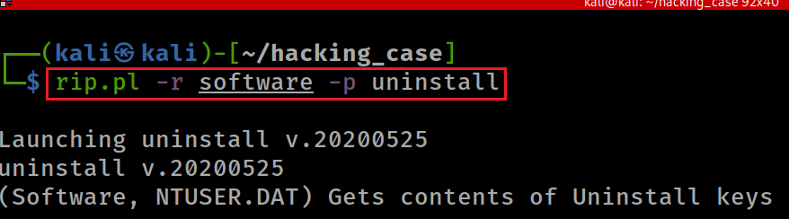
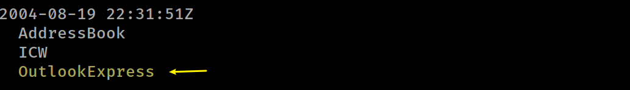
Find new applications installed
Notes:
rip.pl -r software -p uninstall

Slide 42
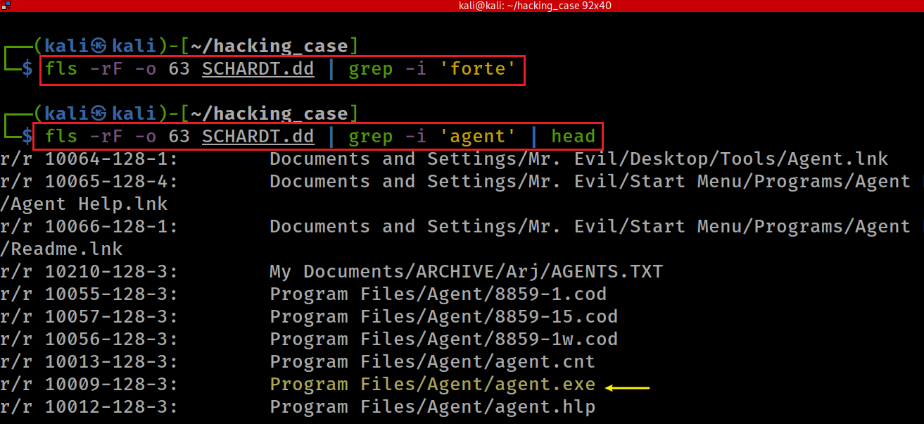
Search for installed Forte Agent using the keyword “forte” or “agents”
nothing
Notes:
fls -rF -o 63 SCHARDT.dd | grep -i 'forte’
fls -rF -o 63 SCHARDT.dd | grep -i 'agent' | head

Slide 43
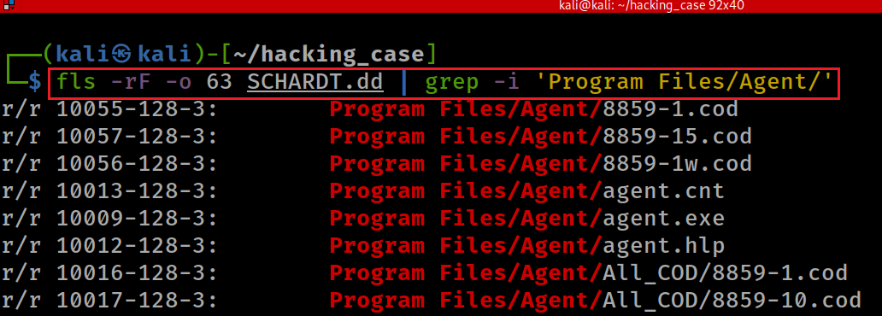
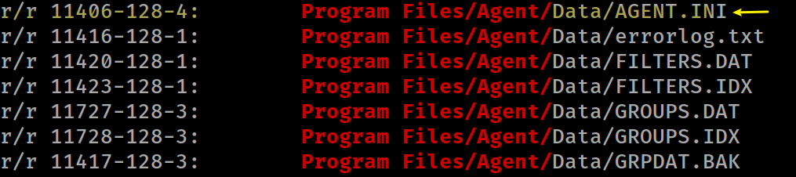
Looking for Forte Agent configuration files or data
Notes:
fls -rF -o 63 SCHARDT.dd | grep -i 'agent' | head

Slide 44
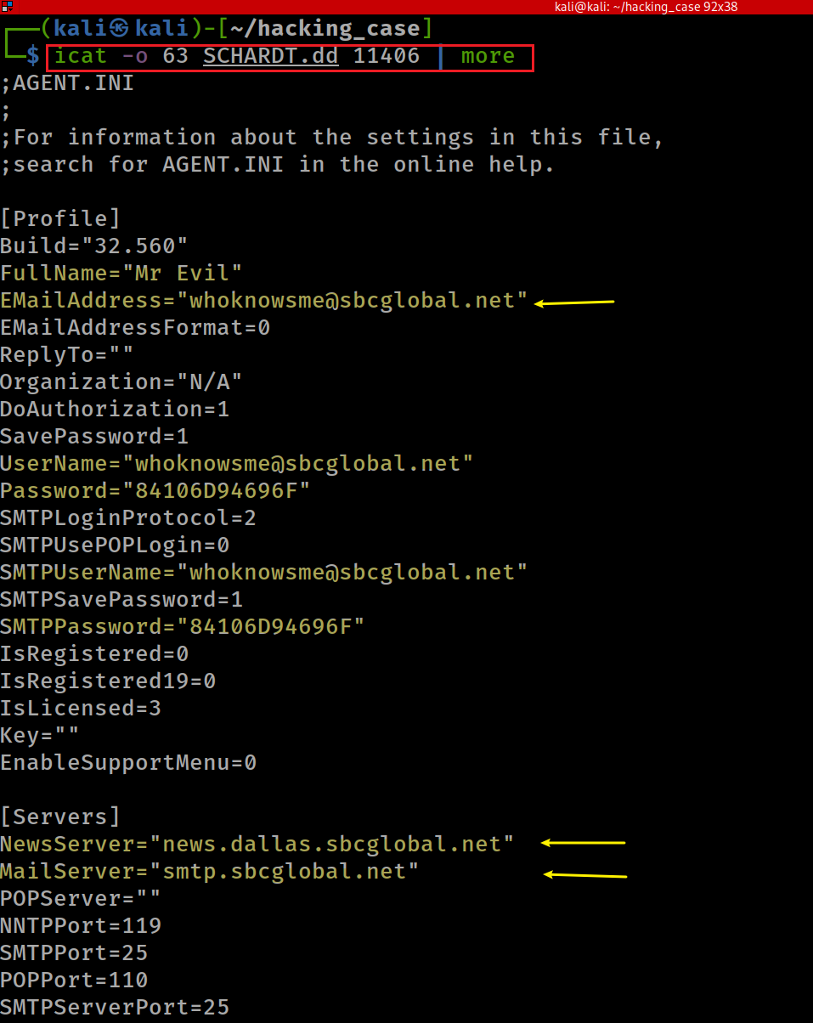
Find news server configuration
Notes:
icat -o 63 SCHARDT.dd 11406 | more
NewsServer="news.dallas.sbcglobal.net"
MailServer="smtp.sbcglobal.net"

Slide 45
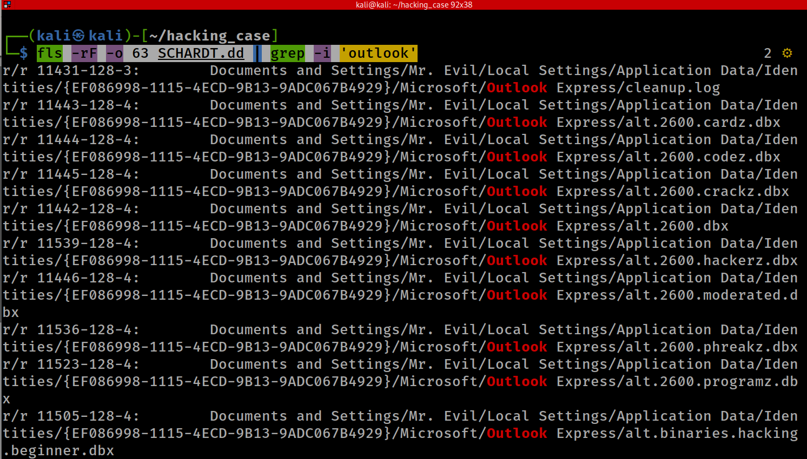
List all files that are associated with outlook express by searching the key work “outlook”
Notes:
fls -rF -o 63 SCHARDT.dd | grep -i 'outlook’
r/r 11431-128-3: Documents and Settings/Mr. Evil/Local Settings/Application Data/Identities/{EF086998-1115-4ECD-9B13-9ADC067B4929}/Microsoft/Outlook Express/cleanup.log
r/r 11443-128-4: Documents and Settings/Mr. Evil/Local Settings/Application Data/Identities/{EF086998-1115-4ECD-9B13-9ADC067B4929}/Microsoft/Outlook Express/alt.2600.cardz.dbx
r/r 11444-128-4: Documents and Settings/Mr. Evil/Local Settings/Application Data/Identities/{EF086998-1115-4ECD-9B13-9ADC067B4929}/Microsoft/Outlook Express/alt.2600.codez.dbx
r/r 11445-128-4: Documents and Settings/Mr. Evil/Local Settings/Application Data/Identities/{EF086998-1115-4ECD-9B13-9ADC067B4929}/Microsoft/Outlook Express/alt.2600.crackz.dbx
r/r 11442-128-4: Documents and Settings/Mr. Evil/Local Settings/Application Data/Identities/{EF086998-1115-4ECD-9B13-9ADC067B4929}/Microsoft/Outlook Express/alt.2600.dbx

Slide 46
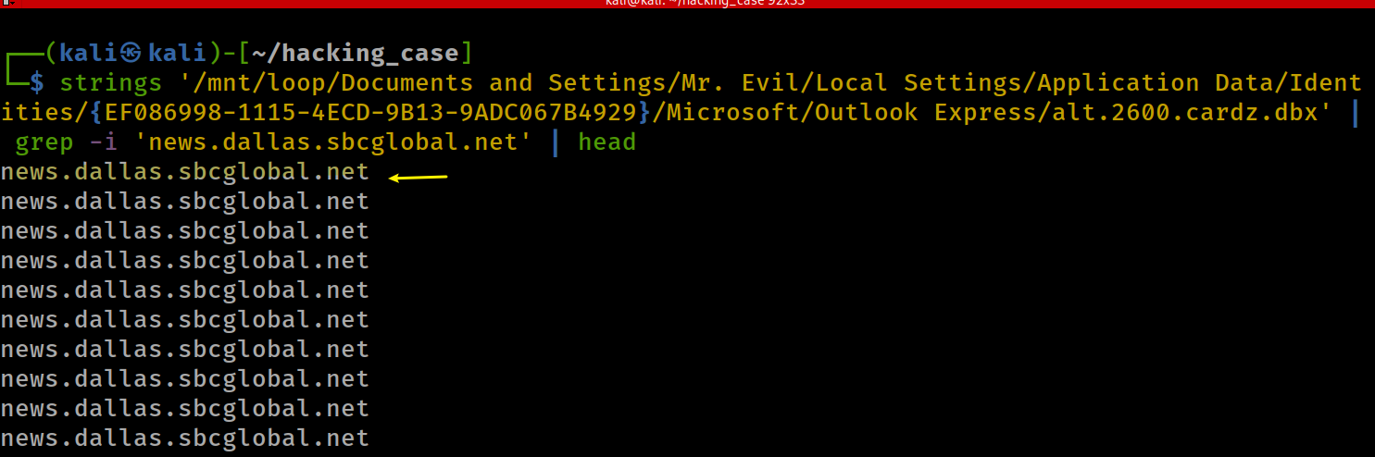
Find the news server:news.dallas.sbcglobal.net in the .dbx (outlook express format)
Notes:
news.dallas.sbcglobal.net

Slide 47
19. What two installed programs show this information?

Slide 48
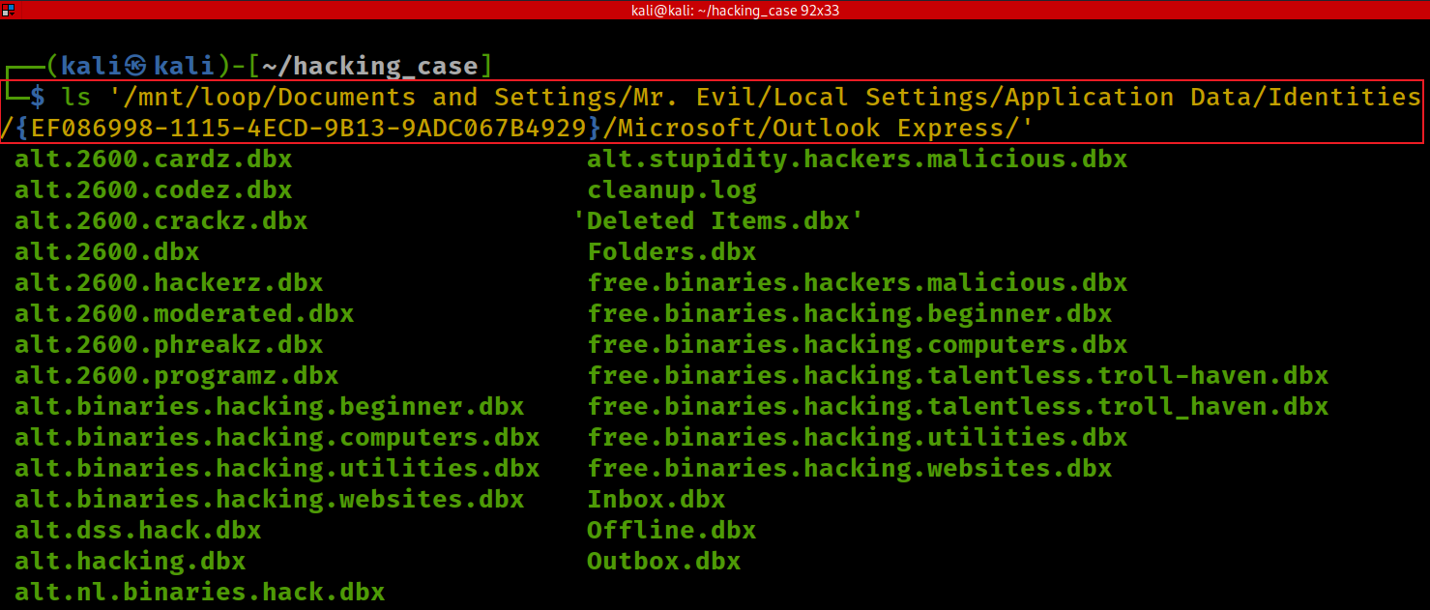
20. List 5 newsgroups that Mr. Evil has subscribed to?
Notes:
ls '/mnt/loop/Documents and Settings/Mr. Evil/Local Settings/Application Data/Identities/{EF086998-1115-4ECD-9B13-9ADC067B4929}/Microsoft/Outlook Express/'
alt.2600.cardz.dbx alt.stupidity.hackers.malicious.dbx
alt.2600.codez.dbx cleanup.log
alt.2600.crackz.dbx 'Deleted Items.dbx'
alt.2600.dbx Folders.dbx
alt.2600.hackerz.dbx free.binaries.hackers.malicious.dbx
alt.2600.moderated.dbx free.binaries.hacking.beginner.dbx
alt.2600.phreakz.dbx free.binaries.hacking.computers.dbx
alt.2600.programz.dbx free.binaries.hacking.talentless.troll-haven.dbx
alt.binaries.hacking.beginner.dbx free.binaries.hacking.talentless.troll_haven.dbx
alt.binaries.hacking.computers.dbx free.binaries.hacking.utilities.dbx
alt.binaries.hacking.utilities.dbx free.binaries.hacking.websites.dbx
alt.binaries.hacking.websites.dbx Inbox.dbx
alt.dss.hack.dbx Offline.dbx
alt.hacking.dbx Outbox.dbx
alt.nl.binaries.hack.dbx

Slide 49
21. Investigate an Internet Relay Chat program
A popular IRC (Internet Relay Chat) program called MIRC was installed. What are the user settings that was shown when the user was online and in a chat channel?
Find new applications installed
Find the application installation directory
Search for configuration files or key words

Slide 50
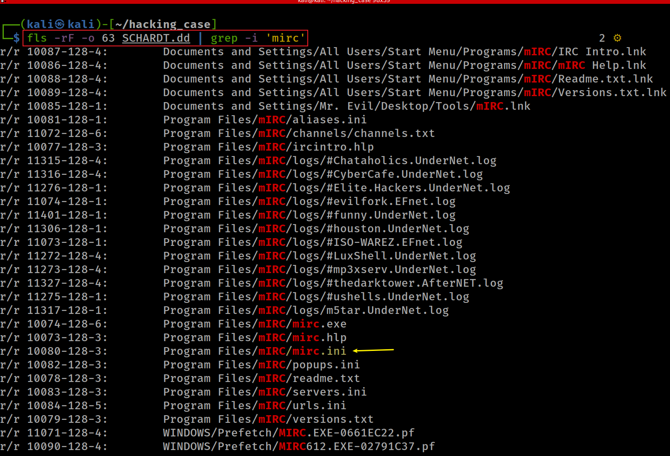
Find mIRC installation directory
Notes:
fls -rF -o 63 SCHARDT.dd | grep -i 'mirc'

Slide 51
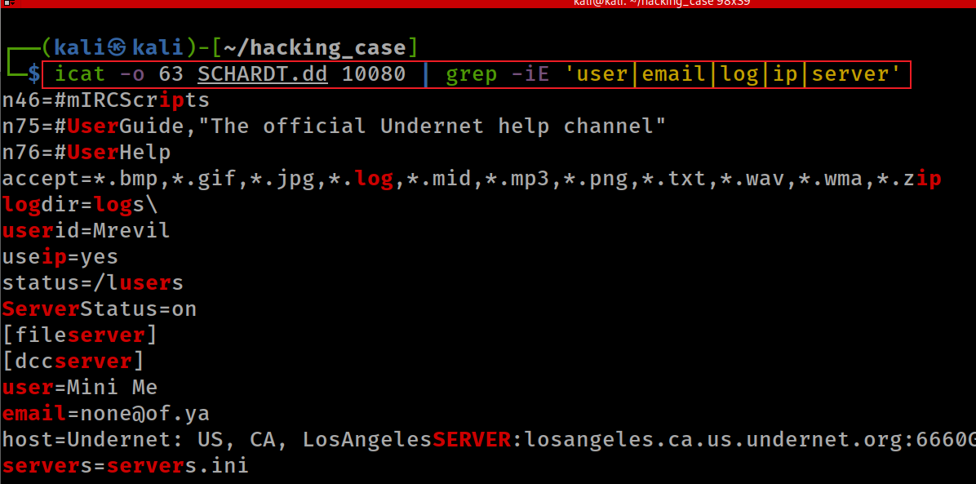
Find some important configuration
This IRC program has the capability to log chat sessions.
Notes:
icat -o 63 SCHARDT.dd 10080 | grep -iE 'user|email|log|ip|server'

Slide 52
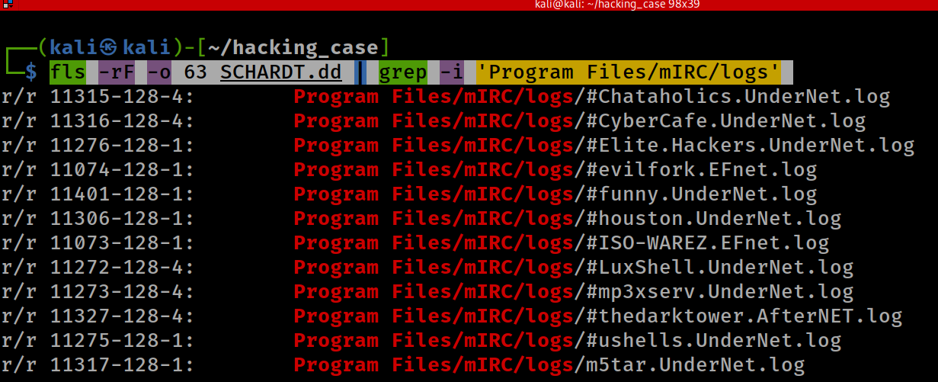
22. List 3 IRC channels that the user of this computer accessed.
Notes:
fls -rF -o 63 SCHARDT.dd | grep -i 'Program Files/mIRC/logs'

Slide 53
23. Investigate Ethereal
Ethereal, a popular “sniffing” program that can be used to intercept wired and wireless internet packets was also found to be installed.
When TCP packets are collected and re-assembled, the default save directory is that users default documents directory.
What is the name of the file that contains the intercepted data?
Find the location \Document and Setting\Mr. Evil
Search for TCP packets saved (.pcap)

Slide 54
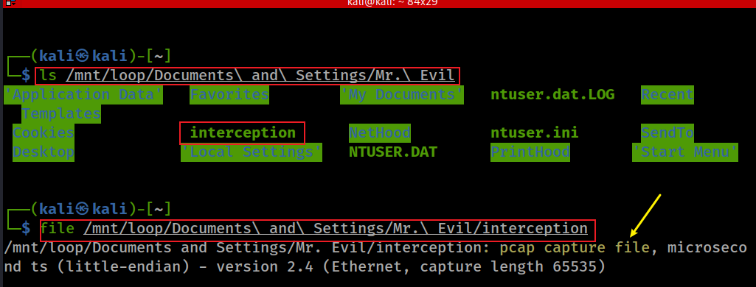
Find the type of file using file command
Notes:
ls /mnt/loop/Documents\ and\ Settings/Mr.\ Evil
file /mnt/loop/Documents\ and\ Settings/Mr.\ Evil/interception

Slide 55
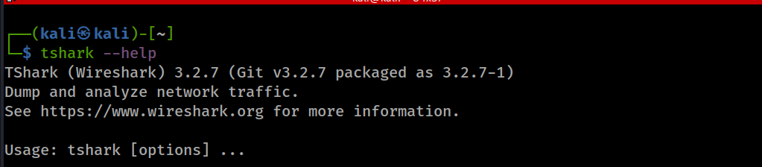
24. What type of device was the victim (person who had his internet surfing recorded) using?

Slide 56

Search for user agent from http request
Notes:
tshark -r /mnt/loop/Documents\ and\ Settings/Mr.\ Evil/interception -Y http.request -T fields -e http.user_agent -e http.host

Slide 57

25. What websites was the victim accessing?
Sort the requests with unique entries
Notes:
tshark -r /mnt/loop/Documents\ and\ Settings/Mr.\ Evil/interception -Y http.request -T fields -e http.user_agent -e http.host | sort -u

Slide 58

26. Search for the main user’s web-based email address. What is it?
Understand Extended Regular Expression (ERE)
Basic vs Extended Regular Expressions
In basic regular expressions the meta-characters ?, +, {, |, (, and ) lose their special meaning; instead use the backslashed versions \?, \+, \{, \|, \(, and \).
Pre-defined classes
[:alnum:], [:alpha:], [:blank:],
[:cntrl:], [:digit:], [:graph:],
[:lower:], [:print:], [:punct:],
[:space:], [:upper:], [:xdigit:]
Notes:
https://man7.org/linux/man-pages/man1/egrep.1.html

Slide 59


-E: Extended Regular Expression
-i: ignore case
-o: show only match, not whole lines
-r: recursive
-h: don’t show file name
-I: ignore binary files
Notes:
grep -EiorhI '([[:alnum:]_.-]+@[[:alnum:]_.-]+?\.[[:alpha:].]{2,6})' '/mnt/loop/Documents and Settings/Mr. Evil/’
grep -EiorhI '\b[A-Za-z0-9._%+-]+@[A-Za-z0-9.-]+\.[A-Za-z]{2,6}\b' '/mnt/loop/Documents and Settings/Mr. Evil/'

Slide 60

Sort all emails, count them, and sort again based on counts
uniq options:
-c, --count
prefix lines by the number of occurrences
sort options:
-n, --numeric-sort
compare according to string numerical value
-r, --reverse
reverse the result of comparisons
Notes:
grep -EiorhI '([[:alnum:]_.-]+@[[:alnum:]_.-]+?\.[[:alpha:].]{2,6})' '/mnt/loop/Documents and Settings/Mr. Evil/' | sort | uniq -c | sort –nr
mrevilrulez@yahoo.com

Slide 61

27. Yahoo mail saves copies (web cache) of the email under what file name?
Search email under Mr. Evil’s account
Notes:
grep -ir 'mrevilrulez@yahoo.com' '/mnt/loop/Documents and Settings/Mr. Evil/'

Slide 62

View cached webpages

Slide 63

28. How many executable files are in the recycle bin?
Notes:
ls '/mnt/loop/RECYCLER/S-1-5-21-2000478354-688789844-1708537768-1003'

Slide 64
29. Are these files really deleted?
No. They can be restored.
We will try to recover the deleted files’ information

Slide 65
Recover deleted files’ information
Extract deleted file from Windows Recycle Bin
using Rifiuti2
Rifiuti2 is a for analyzing Windows Recycle Bin INFO2 file.
The complete path and file or folder name is stored in a hidden file called INFO2 which is inside the Recycled or Recycler folder.
Rifiuti2 can extract
file deletion time,
original path
size of deleted files ad
whether the trashed files have been permanently removed.
Notes:
https://github.com/abelcheung/rifiuti2

Slide 66

rifiuti2 features
Handles oldest (Win95) to newest (Win 10 and Server 2019) recycle bin format
Windows 95 – 2003 uses a single index file named INFO or INFO2
Vista or above uses one index file for each deleted item
64-bit file size support
Supports all localized versions of Windows — both Unicode-based ones and legacy ones (using ANSI code page)
Supports output in XML format as well as original tab-delimited text
Obscure features such as recycle bin on network share (\\server\share)

Slide 67


Install rifiuti2
Install using apt
Check the verion
Notes:
sudo apt-get install rifiuti2

Slide 68


Show Recycler Bin
Show INFO2 in Recycler Bin
Notes:
ls -l '/mnt/loop/RECYCLER/S-1-5-21-2000478354-688789844-1708537768-1003'

Slide 69


Slide 70

Show the full path of deleted files
Notes:
rifiuti2 '/mnt/loop/RECYCLER/S-1-5-21-2000478354-688789844-1708537768-1003/INFO2'

Slide 71

30. How many files are actually reported to be deleted by the file system?
Show deleted files (365)
Notes:
fls -rFd -o 63 SCHARDT.dd | wc -l

Slide 72
31. Perform an Anti-Virus check. Are there any viruses on the computer?
Suspect may produce virus/be infected.
Use Clam AntiVirus to scan Windows
ClamAV is a free software, cross-platform and open-source antivirus software toolkit able to detect many types of malicious software, including viruses.
One of its main uses is on mail servers as a server-side email virus scanner.

Slide 73


Installation and verification
Notes:
sudo apt-get install clamav

Slide 74

Scan results

Slide 75
What is your conclusion?
is Greg Schardt a hacker?

